Slide 1

Meet The Teacher
Essential Guide for Parents and Carers of Children in Year 2
at Cleveland Road Primary School

Slide 2
Welcome to Year 2
Class teacher: Mrs Easter
Additional staff: Miss Miah & Ms Begum
* Mr Albert (Music)
* Mr Nichols (PE coach)
* Ms Towli (Dance)
* Señor Jones (Spanish)
ULT Link: Mrs Padda

Slide 3
Behaviour
Our behaviour policy is available on the school website
Please encourage your child to follow the 5Cs:
    Care
    Courtesy
    Co-operation
    Consideration
    Commitment
    Pupils will receive teacher and peer commendation awards for demonstrating the 5Cs in school. These will be published in the weekly newsletter.
    If your child does not follow the 5Cs after a verbal reminder, they will be asked to fill out a reflection sheet. You may be called to meet with the class teacher to discuss this further.

Slide 4

Communication
Home-School agreement
The home-school agreement is on the school website; please sign the copy in your child’s home-school communication book and ensure that you follow the guidance and meet the expectations outlined in this document.
Please remember to access the links on this page, view this powerpoint as a slideshow and you will be able to click on the blue underlined link.
Home-School Communication Book
This provides the link between the parent and the teacher.
Any letters will be communicated to you using the Home-School Communication Book: to inform you of important dates and/or events that are taking place at school. Please ensure that you check your child’s Home-School Book and school bag each day.
Feel free to use the book to communicate with your child’s class teacher. Children are responsible for passing on the book to the class teacher
Additional reminders and information are sent out via email, using ParentHub and the school newsletter

Slide 5
The School Day
Children are admitted from 8.45am-8.55am
8.55 am is the time by which children MUST be seated and ready to start the day
Lateness has a huge impact on your child’s learning. Please ensure that your child is in school on time every day
Lessons finish at 3.15pm. Classroom doors will open shortly after this and children taught in upstairs’ classes will be in the playground hereafter.
Please give the classes space to exit the building. Your patience is appreciated as we ensure that your children are collected safely

Slide 6
Attendance
Regular attendance and punctuality at school is an important factor in ensuring that children benefit from their education.
Facts about poor attendance
Missing out on lessons leaves children vulnerable to falling behind.
Children with poor attendance tend to achieve less in both primary and secondary school.
The Education (School Day and School Year) (England) Regulations 1999 require all maintained schools to open to educate their pupils for at least 190 days (380 sessions) in each school year.
School term times are on the school website
Extended leave: the school has adopted the Redbridge policy.
No leave is to be taken during term time

Slide 7

Every Lesson Counts!
Did you know?
Please ensure punctuality to maintain school attendance.
If your child’s attendance during the school year was… 95% 90% 85% 80% 75% | Your child would have lost approximately… 9 days from school 19 days from school 29 days from school 38 days from school 48 days from school | Or they would have missed approximately… 50 lessons 100 lessons 150 lessons 200 lessons 250 lessons

Slide 8


Slide 9
Absence
If your child is not able to attend school, please ring the school office by 8.30am
Your child’s attendance and punctuality is tracked and reported to the Educational Welfare Officer
The school will follow up on significant absences
Once your child has returned to school, they must bring a letter to explain the absence
Applications for leave in exceptional circumstances can be made through the school office

Slide 10
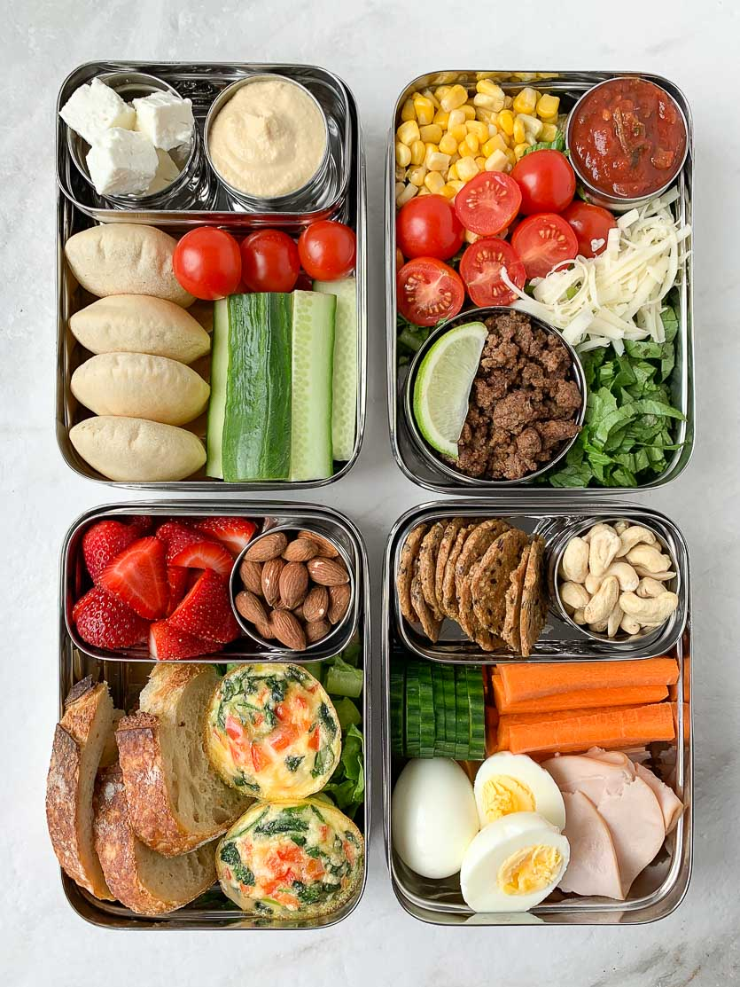

Playtime and Lunchtime
Please support us in encouraging your child to adopt a healthy lifestyle
A bottle of fresh water should be brought in each day
Pupils in EYFS and KS1 are provided with a piece of fruit or veg each day
Children should not bring any sweets, crisps or chocolate to school
Cleveland Road Primary School is a nut-free school
This includes party bags- please ensure that party bags do not include sweets, crisps, cakes or chocolate

Slide 11
Pupil Premium Funding
You are entitled to additional funding, for the school to support your child, if you receive any of the following:
  Income Support
  Income-based Jobseeker’s Allowance
  Income-related Employment and Support Allowance
  Support under Part VI of the Immigration and Asylum Act 1999
  The guarantee element of Pension Credit
  Child Tax Credit (provided you’re not also entitled to Working Tax Credit and have an annual gross income of no more than £16,190) - Working Tax Credit is a disqualifying benefit regardless of your household income - this means that you would not be entitled to Free School Meals whilst in receipt of Working Tax Credit
  Working Tax Credit run-on – paid for four weeks after you stop qualifying for Working Tax Credit
  Universal Credit (provided you have an annual net earned income of no more than £7,400, as assessed by earnings from up to three of your most recent assessment periods)
To apply online, visit the Redbridge website https://www.redbridge.gov.uk/schools/free-school-meals/
Even though every child now receives a universal FSM, you should still apply as it will provide the school with extra funding for your child

Slide 12
Before- and After-School Clubs
  We are looking forward to restarting this provision in the near future. We are very fortunate that so many clubs are offered voluntarily by teachers at Cleveland Road Primary School
  Letters regarding clubs are sent out termly
  Please ensure that if your child is successful in securing a place within a particular club, that they make a commitment to attending every week
  It would be courteous for your child to let the club teacher know, in advance, if they cannot attend so that the place may be offered to another child

Slide 13



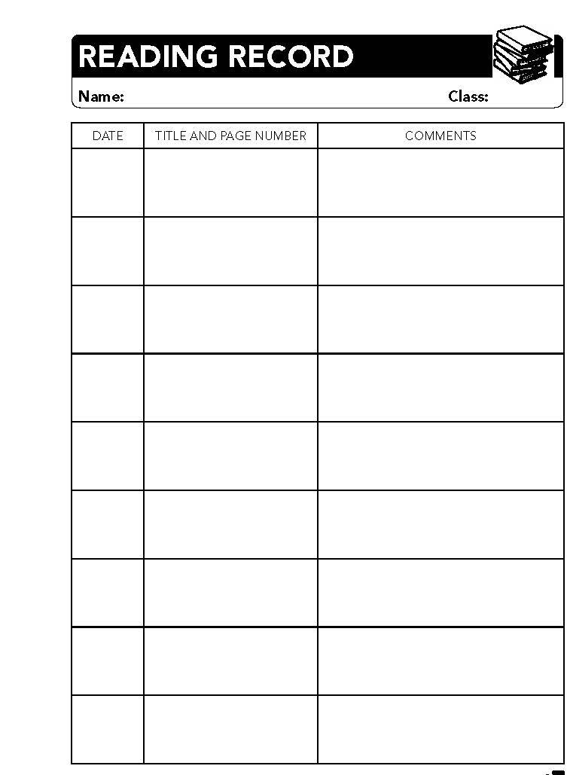
Curriculum
Reading
Reading at home is an essential daily activity: children who are heard reading at home, in addition to school reading activities, perform better in school work and all tests
Parents should read at home every day with their children and should sign the reading record each time
Reading will be regularly monitored in school
Membership of and visits to libraries are encouraged
Guides for how to read with your child and suggested reading lists are available on the school website.

Slide 14

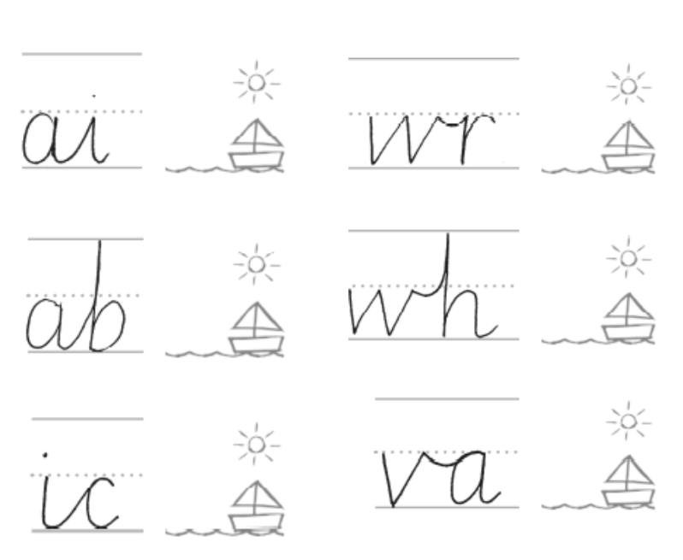
Curriculum
Writing
Students should be thinking about high-quality presentation in all their work, using joined, legible handwriting
Spelling
All the spelling scheme spelling lists are available on the website in Curriculum/English/Spelling
Topic
This term’s theme is Notable Victorians
Visit the curriculum section of our school website to find out more about our curriculum and what your child is learning

Slide 15
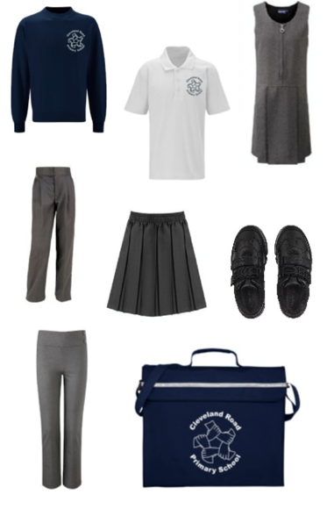






Uniform
The children have started the school year looking very smart!
A reminder: girls’ tights/socks must be grey; trainers must be black and should not have large logos on them; all shoes must have flat heels (open-toed shoes are not appropriate); boots should only be worn in very cold weather; headscarves should be plain white or navy; no nail polish; no make-up
Only stud earrings and watches are permitted.
PE Kit:
PE is part of the National Curriculum and is, therefore, a legal requirement.
Jewellery must be removed for all P.E. lessons; the items remain the responsibility of the child. If children are wearing stud earrings that cannot be removed, these should be covered with micropore tape provided by the parent.
On PE days, children should wear their kit to school. This should be as follows: Plain white polo shirt or t-shirt, Navy jogging bottoms, Navy school jumper/sweatshirt, black Plimsolls or trainers
2E PE days: Monday & Thursday

Slide 16

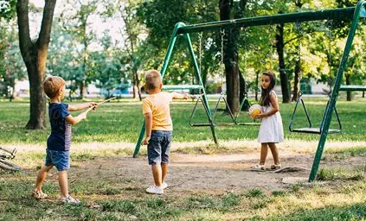
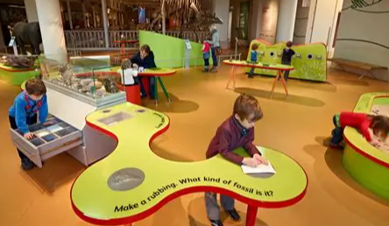
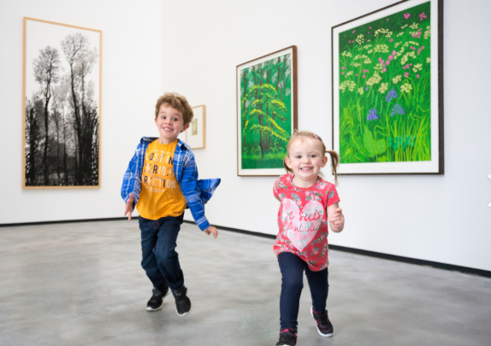

Homework
  How to support your child at home:
  Please check and sign each piece of homework to state that you are happy with the quality
  Reading at home is expected to take place 5 times per week.
  Offer encouragement and guidance
  Take your child to the library regularly; limit the time your child’s screen time; go to the park and encourage physical exercise; look for opportunities to explore museums, galleries and other places of interest; check out the newsletter and school Twitter pages for events happening in Redbridge and around London; our website has a wide range of learning tools that your child can access at home
  When is homework given out and returned?
  Homework is given out by set and class teachers; this should be returned when requested.
  Homework is given weekly; the majority of the time it will be given out on Friday and returned Wednesday.

Slide 17

Online Safety and the School Website
  Online safety is an important part of keeping children safe. Visit our website for more information about our SMART rules for keeping safe online. You will also find our pupil Acceptable Use Agreements (AUPs) which detail our expectations for pupil’s online behaviour. Please discuss these with your child.
  The School Website
  Please visit and explore our website regularly as we are continuously adding new content. Here are a few key places to start your visit:
    The Cleveland Curriculum
    The Newsletter
    Parents/useful information (term dates, uniform, school meals and much more)
    Learning tools to support learning at home
  Useful Links for parents

Slide 18
Mobile Phones
  To ensure the safety and smooth collection of our children at the end of the day, we kindly ask parents and carers not to use their mobile phone while collecting their child from school.
  Please give your full attention when collecting children from school, especially moving around the school grounds and crossing the roads.

Slide 19

Eating Healthily: Small Changes Makes a Big Difference
Although we have seen a big improvement in the lunches many children are bringing into school, there are always ways we can improve our children’s diets and help them to lead healthier lives. Here are some simple ideas to get you started:
  Make one change at a time.
  Always include a starchy food such as bread, pasta or rice, in each meal.
  Peel or chop fruit and vegetables and put them in a small pot or bag to increase the chances of your child eating them.
  If your child likes sweet foods, swap a chocolate bar for raisins or grapes. If they prefer savoury foods, swap the crisps and give them carrot sticks or plain popcorn.
  Swap sugary squash and juice drinks for water or milk. Do not send juice into school with your child’s packed lunch – water only!
  Swap processed cheese for real cheese like Edam or cheddar.
  Further tips are available on the school website.

Slide 20

Key Dates
  Term dates are available on the school website: Term Dates and are also outlined in this document
  You will be informed, by letter, of any visits or workshops organised for the year group

Slide 21
Autumn Term 2026
Autumn 2026
Start of term: Monday 7th September 2026
Half term: Monday 26th October to Friday 30th October 2026
End of term: Friday 18th December 2026 – school closes at 1:30pm for pupils
Christmas break: Monday 21st December 2026 to Friday 1st January 2026
In-service training days: Wednesday 2nd September 2026, Thursday 3rd September 2026 and Friday 4th September 2026
Parents’ Consultation Meeting: Wednesday 21st October 2026

Slide 22
Spring Term 2027
Start of term: Monday 4th January 2027
Half term: Monday 15th February to Friday 19th February 2027
End of term: Thursday 25th March 2027– school closes at 1:30pm for pupils
Spring break: Friday 26th March to Friday 9th April 2027
In-service training day: TBC
Parents’ Consultation Meeting: Wednesday 10th February 2027

Slide 23
Summer Term 2027
Start of term: Monday 12th April 2027
Half term: Monday 31st May to Friday 4th June 2027
End of term: Thursday 22nd July 2027 – school closes at 1:30pm for pupils
In-service training day: TBC
Open Evening: Thursday 8th July 2027 (TBC)

Slide 24
Parent Hub
  All parents and carers need to keep informed about what is happening in school
  ParentHub is completely free to download and set-up is easy
  Visit the App Store or Google play to download the free app and start receiving all the messages, letters and newsletters directly to your phone
  Call the school office if you need any help setting it up

