Slide 1

Parents and Carers Guide to School Uniform

Slide 2
Uniform
All children will need to wear school uniform to Reception. Wearing a uniform creates a sense of unity and belonging as well as helping with transition into school
The school colours are navy blue, white and grey
Children will need a pair of wellington boots which can remain at school as children will access outdoor learning during the different seasons
Only stud earrings are allowed at school for health and safety reasons
Blue and white dresses may be worn in the summer months
Our school uniform provider is Mapac. Full details can be found via our school website
Macpac sells a range of items that include the school logo including book bags and PE kit bags

Slide 3
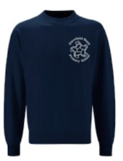
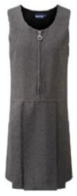
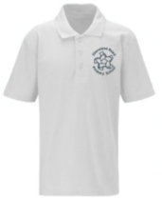
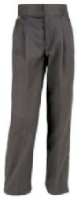
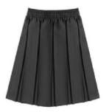
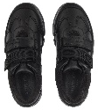


Uniform List

Slide 4
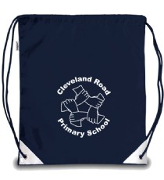
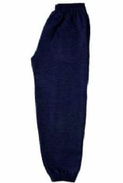
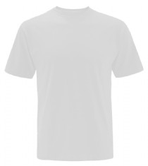
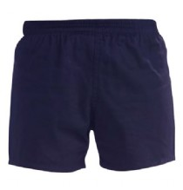
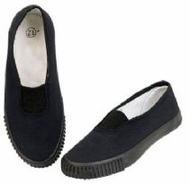
PE Kit

