Slide 1
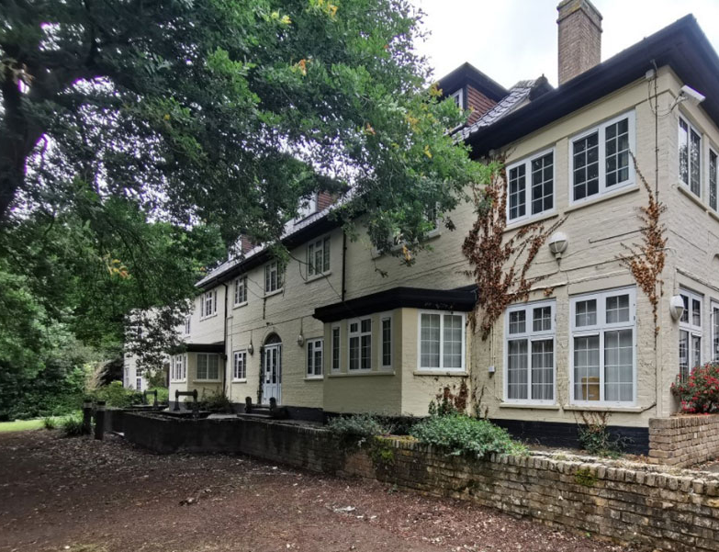
Fairplay House
A guide for parents

Slide 2
Introduction
Fairplay House is a large, 1930s-built country house
It is located in Wickham Bishops, in Essex
Young people stay in dormitories

Slide 3

Fairplay House

Slide 4

The Grounds
There are extensive, immaculately landscaped gardens
Within the gardens are:
  An artificial climbing wall
  An outdoor swimming pool
  An obstacle course and an orienteering course
  An archery range
  Volleyball courts and a football pitch
  An underground area in which you can experience the conditions faced by cavers
  A high ropes course

Slide 5
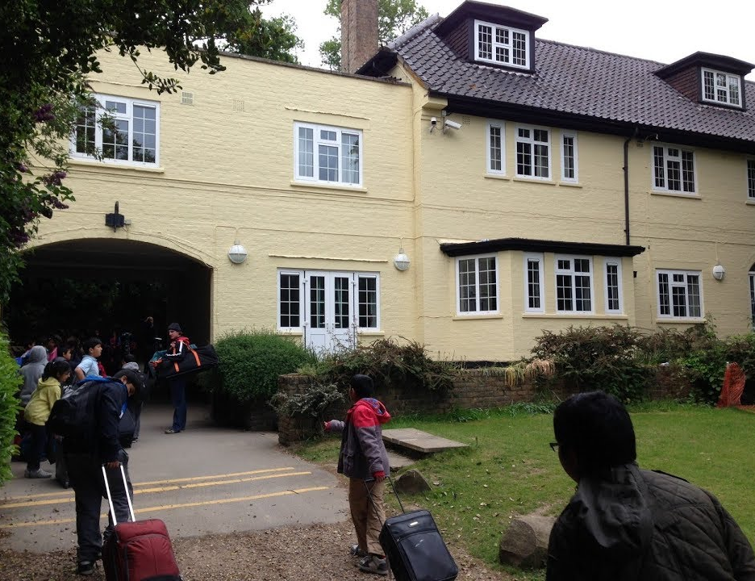
A warm welcome
Children arriving at Fairplay House

Slide 6
Fair Play House
Wednesday 14th -Friday 16th February 2024
The coach will leave the school at 9.00am on Wednesday 14th February
Children should arrive at the earlier time of 8.30am
Expect them back at school by 3.15pm on Friday 16th February
Medication: children should not bring any medication except asthma pumps, unless already agreed (medication given to Mr Omar, labelled)

Slide 7
SUGGESTED EQUIPMENT
Complete changes of underwear and socks (enough for your stay)
Three warm sweaters or sweatshirts
Enough shirts, T-shirts or similar for your stay
(at least 1 per day; extras are a good idea as the children may get wet)
At least two pairs of trousers or track suit bottoms (Please note that jeans are not suitable)
Two pairs of trainers or old shoes; wellington boots (there is a limited supply at Fairplay House)
Pyjamas and dressing gown
Two towels and toiletries (toothbrush, toothpaste, soap, flannel, etc.)
One pair of indoor slippers
A waterproof coat or anorak
Gloves, woollen hat or similar; scarf
Each item of clothing, etc. should be clearly marked with the pupil's name.

Slide 8

Expectations…
Pupils should not bring any personal belongings like, mobile phones, MP3 players, Nintendo DS…
Pupils should not wear any jewellery, including earrings; they will not be allowed on any activities if they are wearing jewellery
No pocket money is needed as everything is provided.
Pupils will not be allowed to call home. In case of any emergency the school will contact parents.
Children can bring a reading book, board game and a teddy bear
Emails daily
Photos will be put on website when we get back

Slide 9
Key information
5 members of staff will accompany the children: 3 from Gordon and 2 from Cleveland
Fair Play House is run by the Borough of Newham and has trained instructors.
The children will be provided with cooked meals and packed lunches.
They will sleep in same-gender bedrooms on bunk beds

Slide 10
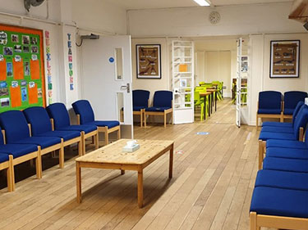
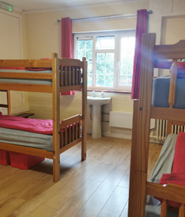
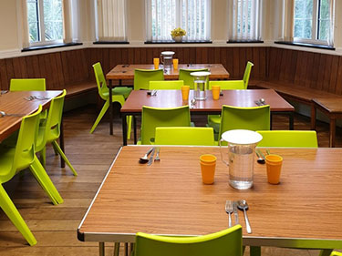
Accommodation
Children staying at Fairplay House get to:
Sleep in bunk beds, in rooms that sleep 4, 8 or 10
Eat in a relaxed, canteen-style dining room
Relax in the evenings in the common room;
play board games and card games, read a book, chat with a friend

Slide 11
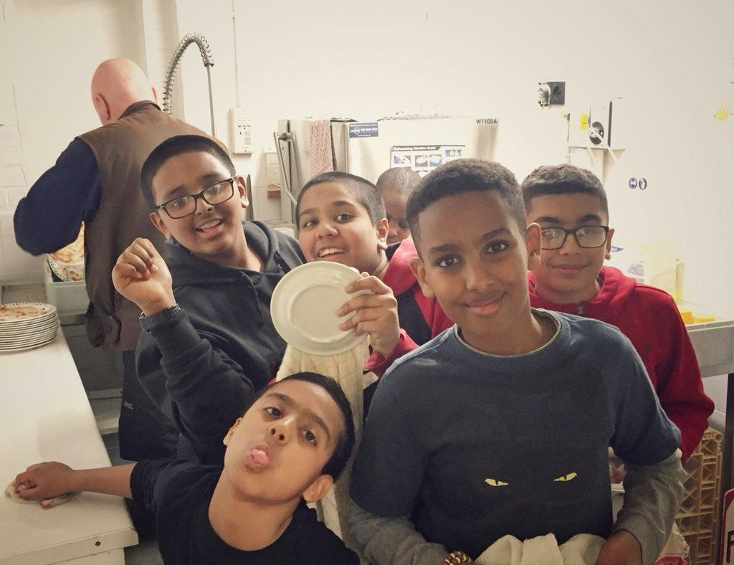
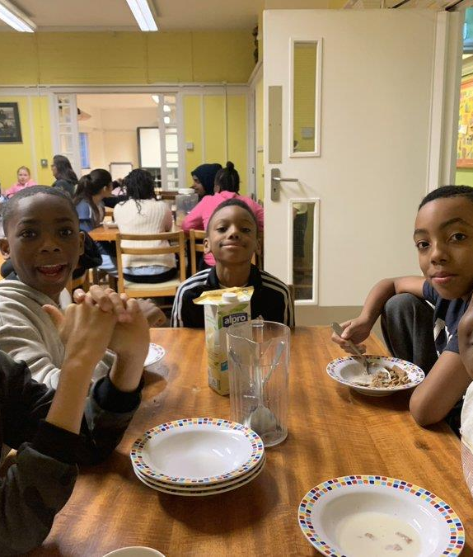

Teamwork
At Fairplay House you do everything together:
Having fun
Mealtimes
Chores and duties

Slide 12

Other Things you should know…
You are placed in 4 groups– each group does activities together
The food is amazing! Everyone
says so!
Breakfast includes toast, beans on toast, cereal – choose 1 or have all!
Lunch – gorgeous, soft rolls with lots of filling choices, crisps, juice and cake!
Hot meals (all Halal) – veggie options, spaghetti Bolognese, pizza, shepherd’s pie, homemade pies
Hot chocolate

Slide 13

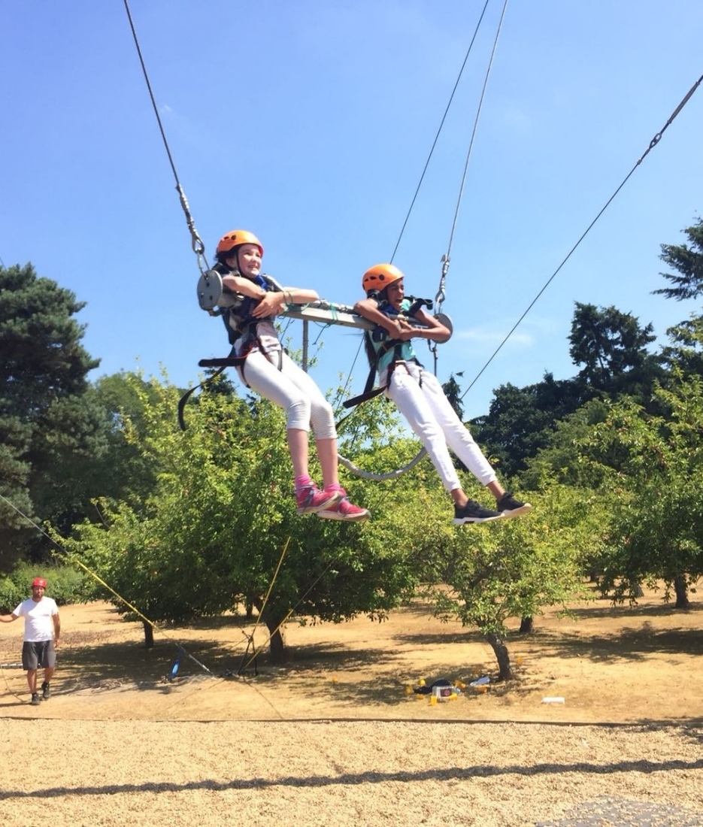

Activities
Giant Swing
Archery
Bushcraft
Zip wire
Night Walk
(which includes map reading)

Slide 14
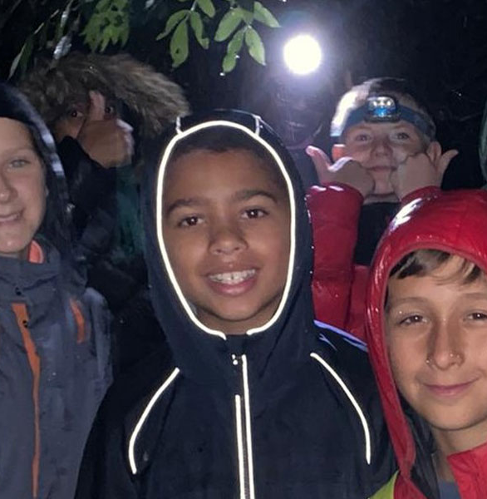
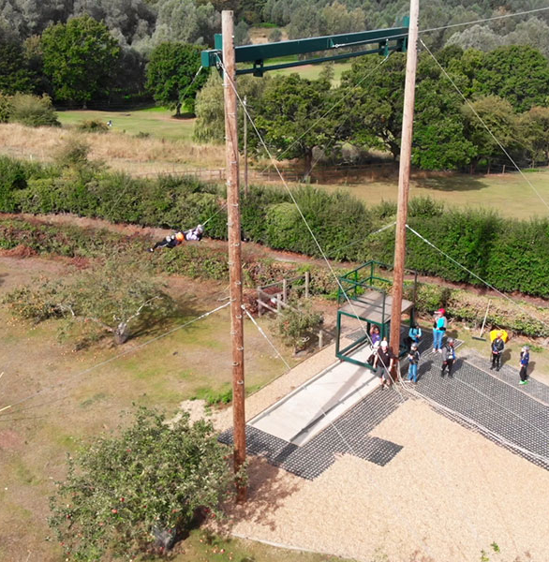

Activities
Night Walk
You are dropped in the middle of nowhere with an adult, a map and a torch and have to make your way back to the house!
Giant Swing
Zip Wire

Slide 15
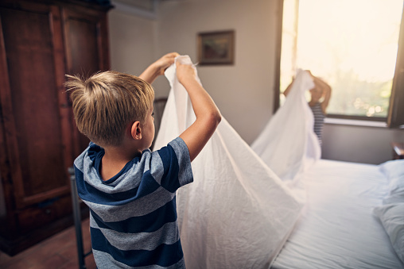
Life Skills
Making their own beds!
Bedding is provided - you don’t need to send any!

Slide 16
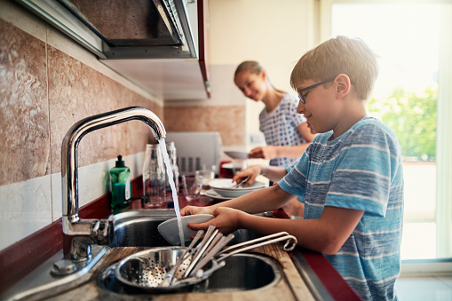
Washing Up!

Slide 17
Fine dining!

Slide 18
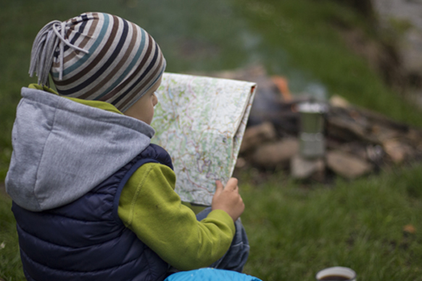
Problem-solving!

Slide 19
Any questions?

Slide 20
Before you leave, please notify a member of the team if you have not yet informed us about medications your child will need or have not completed the form – we will get this information today
You should not send in medicines that have not been agreed with school in advance of the visit

