Slide 1
Read Write Inc.
Notes:
It is a very a successful programme

Slide 2
Read Write Inc. Phonics
The reading programme begins at Nursery and ends in Y2
Older children who need to‘catch-up’
Children new to English
Children with SEN

Slide 3
English alphabetic code
Graphemes are the written letters that represent sounds
Over 150+ graphemes in the English language to represent 44 sounds e.g. ee and ea
we have to group letters together to write some sounds e.g.

Slide 4
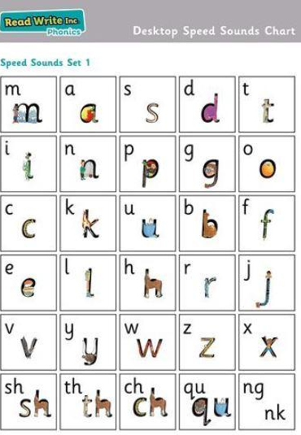
Step 1
Nursery - picture names of each sound
Children learn pure sounds of the alphabet
They begin with learning set 1 sounds in a particular order

Slide 5

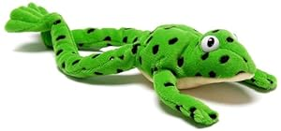
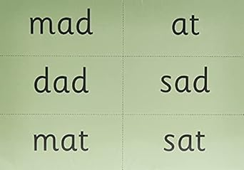
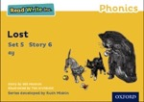
Step 2 - Set 1 Sounds
Learn to read set 1 sounds.
2. blending words orally containing these sounds, called sound blending e.g. m-a-t mat, s-p-o-t spot.
3. Sounding out words with these sounds on paper (1.1-1.7)
4. Read specifically coloured storybooks that match with these sounds e.g. Red book for set 1.

Slide 6
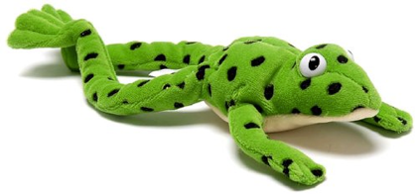
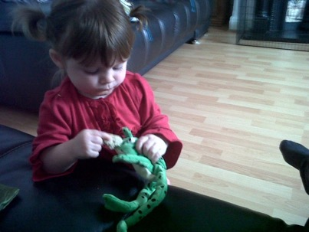
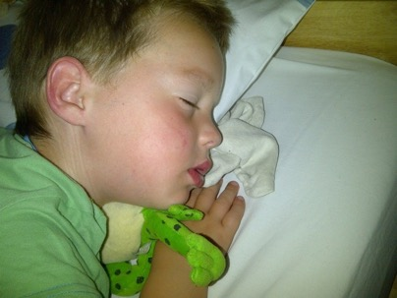
Step 3 - Fred Talk
blending words orally containing these sounds, called sound blending e.g. m-a-t mat, s-p-o-t spot.
Notes:
This is Fred.
He is a frog who can only speak in sounds, and we call this Fred Talk. For example ‘m’ ‘a’ ‘t’, ‘l’ ‘u’ ‘n’ ‘c’ ‘h’.
He helps children sound out words so they can read and spell.
MTYT some examples with the parents. For example ‘m’ ‘a’ ‘t’ mat, ‘s’ ‘a’ ‘t’ sat.
Click. Fred is our friend!

Slide 7
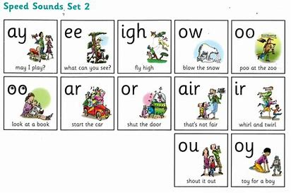
Step 4 - Set 2 Sounds
Learn how to read words with these sounds e.g. ay play
Read specifically coloured books to match these sounds e.g. Pink books
Notes:
They are all special friends

Slide 8
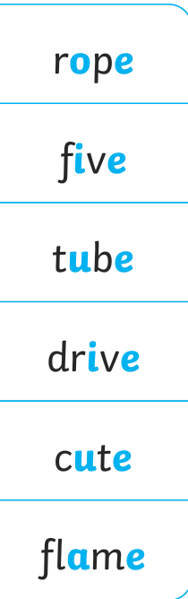
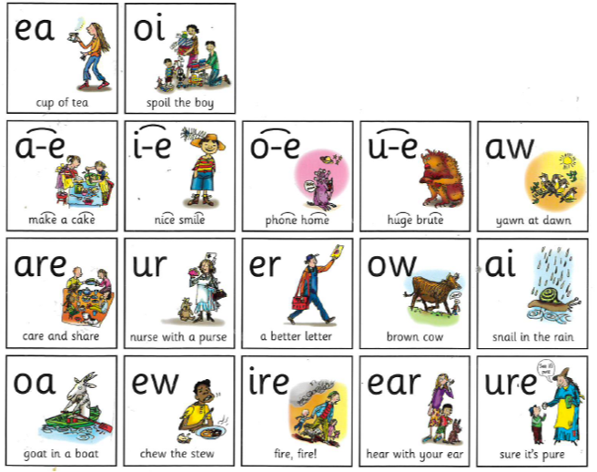
Step 4 - Set 3 Sounds
Split diagraphs

Slide 9
Complex Speed Sounds chart
Notes:
Once they can Fred Talk and blend sounds into words from the simple chart, we teach them Set 3 sounds on the complex chart – the other ways of reading and writing each sound so that they can soon read anything.

Slide 10
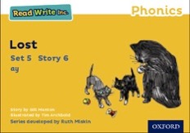
Storybooks
Notes:
Alongside learning each set of sounds, they read Storybooks that only contain the sounds and words they can read. This sets them up to succeed in their reading.
We discuss and write about the ideas in these Storybooks.
We also teach children to read common exception words – words like ‘said’ and ‘they’.

Slide 11
How does Read Write Inc. teach spelling?
Notes:
Read question.

Slide 12

Fred Fingers
Notes:
We use Fred Fingers to help children sound out words to spell easily.
It means they do not have to memorise lists of spelling words.
It is a tool so they will be able to spell any word.
Demonstrate how to use Fred Fingers.

Slide 13
How can I help at home?
Notes:
Read question.

Slide 14


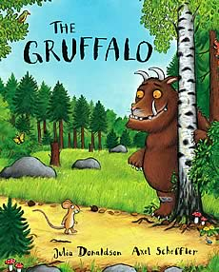

Story Books
Notes:
They will also bring home a picture book to share and enjoy with you at home.
This book has already been read to the class in school so they will care about the story and love hearing the story again and again.

Slide 15
Story Time
You're never too old, too wacky, too wild, to pick up a book and read to a child.
Dr Seuss
Read to your children
Read with your children
Ask lots of questions and share opinions
Notes:
One of the most important things you can do as a parent at home is read higher level texts to your child.
This helps develop an enjoyment for stories and the motivation for learning to read themselves.
Ask questions and share opinions about what you read to engage them in discussion, get them thinking about what they read and develop vocabulary.
Click and read.

Slide 16
Talking
Talk to your child as much as possible and ‘feed’ them new and ambitious vocabulary.
“Let’s eat our lunch now.”
“Let’s munch our lunch now.”
“Let’s scoff our lunch now.”
“Let’s devour our lunch now!”
You’re looking ... not just... but...
Notes:
Click through and read examples to parents.
Use ambitious vocabulary with your children and encourage them to use these words for themselves in both their speech and writing. Build interesting sentences with your child.
A rich vocabulary is essential for high levels of comprehension. The more words your child has in his/her head when they come to school, the quicker they will understand when they read, e.g.
“You’re looking pleased… not just pleased but delighted!” (thrilled/ecstatic/euphoric! Etc)

Slide 17
Online resources available
Ruth Miskin Parents’ Page:
http://www.ruthmiskin.com/en/parents/
Ruth Miskin Facebook:
https://www.facebook.com/miskin.education
Free e-books for home reading:
http://www.oxfordowl.co.uk/Reading/

Slide 18

Questions

Slide 19
Reading feeds the imagination, it expands
horizons and offers new and exciting ways of
seeing and making sense of our lives and of
the world around us.
Michael Morpurgo

